Slide 1


Python Programming Ⅰ
week 6

Slide 2
Python: Functions, Modules

Slide 3
Python: Functions

Slide 4
Topic Structure
Task | Single Value | Multiple Values | numpy, pandas
Presentation (value, variable) | int, float, string, boolean | list, tuple, dictionary, set | ndarray, Series, DataFrame
Operation (algebra) | expressions | operations, mutable operations | expressions, get, set, reshape, …
Control flow | if for while
Use and reuse | Functions Standard libraries Modules and Packages
Input and output | Standard I/O File I/O |  | Standard I/O File I/O CSV, Excel

Slide 5
Learning Objectives
Functions
Function Parameters
return statement
Local Variables
Default Argument Values
Keyword Arguments
VarArgs Parameters
DocStrings

Slide 6
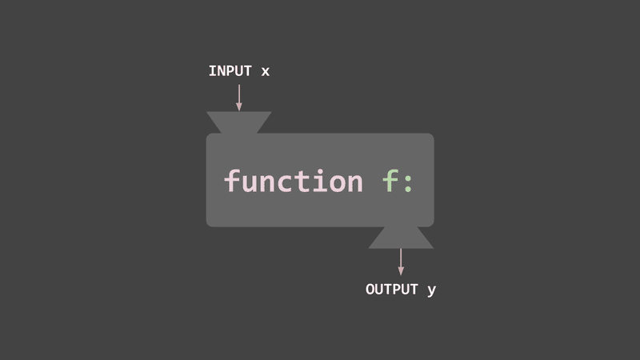
Functions
함수
函數
https://evan-moon.github.io/static/023de5bc6ce10c061b00421bd714ce0c/ee604/thumbnail.png

Slide 7
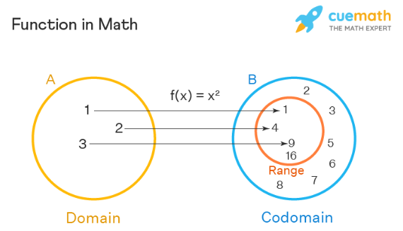
Functions
https://www.cuemath.com/calculus/What-are-functions/

Slide 8
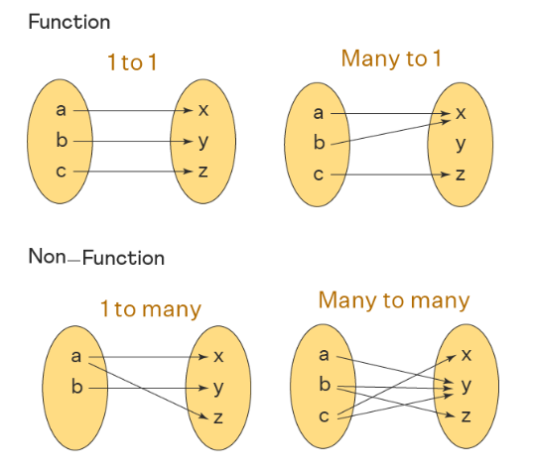
Functions
https://www.cuemath.com/calculus/What-are-functions/

Slide 9
Functions
Functions are reusable pieces of programs.
They allow you to give a name to a block of statements, allowing you to run that block using the specified name anywhere in your program and any number of times.
This is known as calling the function.
We have already used many built-in functions such as len and range.
Notice that we can call the same function twice which means we do not have to write the same code again.

Slide 10
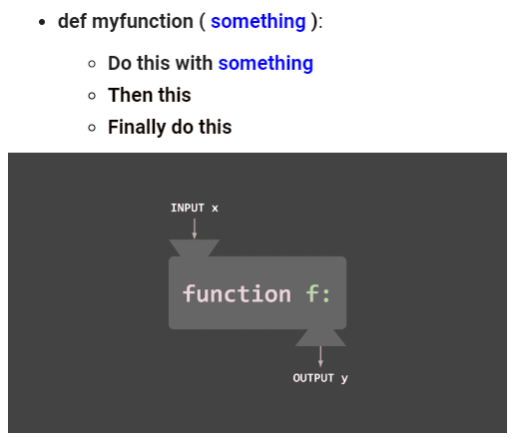
Functions

Slide 11
Syntax of Defining and Calling Functions
Defining a Function
Calling the Function
def name([parameters]):
statements
name([arguments])

Slide 12
Syntax of Defining and Calling Functions
Defining a Function
Calling the Function
def name([parameters]):
statement 1
statement 2
…..
statement n
name([arguments])

Slide 13
Control Flow in Calling Functions
def name([parameters]):
statements
name([arguments])

Slide 14
Control Flow in Calling Functions
def name([parameters]):
statements
name([arguments])
# function call
# calling function name
# calling name

Slide 15
Control Flow in Calling Functions
def name([parameters]):
statements
name([arguments])
# parameter1 = argument1
# parameter2 = argument2
# …
# parameterN = argumentN

Slide 16
Control Flow in Calling Functions
def name([parameters]):
statements
name([arguments])
# parameter1 = argument1
# parameter2 = argument2
# …
# parameterN = argumentN

Slide 17
Control Flow in Calling Functions
def name([parameters]):
statements
# return to calling procedure
name([arguments])
# parameter1 = argument1
# parameter2 = argument2
# …
# parameterN = argumentN

Slide 18
Control Flow in Calling Functions
def name([parameters]):
statements
name([arguments])
# Terminate

Slide 19
Example: Control Flow in Calling Functions
def myprint(i, j):
print(i)
print(j)
myprint(10, 33)

Slide 20
Example: Control Flow in Calling Functions
def myprint(i, j):
print(i)
print(j)
myprint(10, 33)
# function call
# calling function myprint
# calling myprint

Slide 21
Example: Control Flow in Calling Functions
def myprint(i, j):
print(i)
print(j)
myprint(10, 33)
# i = 10
# j = 33

Slide 22
Example: Control Flow in Calling Functions
def myprint(i, j):
print(i)
print(j)
myprint(10, 33)
# i = 10
# j = 33

Slide 23
Example: Control Flow in Calling Functions
def myprint(i, j):
print(i)
print(j)
# return to calling procedure
myprint(10, 33)
# i = 10
# j = 33

Slide 24
Example: Control Flow in Calling Functions
def myprint(i, j):
print(i)
print(j)
myprint(10, 33)
# Terminate

Slide 25
Example: Control Flow in Calling a Function from the Other Function
def myprintf(n):
print("{0:_>5d}".format(n))
print(f"{n:_>5d}")
def myprint(i, j):
myprintf(i)
myprintf(j)
myprint(10, 33)

Slide 26
Example: Control Flow in Calling a Function from the Other Function
def myprintf(n):
print("{0:_>5d}".format(n))
print(f"{n:_>5d}")
def myprint(i, j):
myprintf(i)
myprintf(j)
myprint(10, 33) # calling myprint

Slide 27
Example: Control Flow in Calling a Function from the Other Function
def myprintf(n):
print("{0:_>5d}".format(n))
print(f"{n:_>5d}")
def myprint(i, j):
myprintf(i)
myprintf(j)
myprint(10, 33) # i = 10, j = 33

Slide 28
Example: Control Flow in Calling a Function from the Other Function
def myprintf(n):
print("{0:_>5d}".format(n))
print(f"{n:_>5d}")
def myprint(i, j):
myprintf(i) # calling myprintf
myprintf(j)
myprint(10, 33) # i = 10, j = 33

Slide 29
Example: Control Flow in Calling a Function from the Other Function
def myprintf(n):
print("{0:_>5d}".format(n))
print(f"{n:_>5d}")
def myprint(i, j):
myprintf(i) # n = i = 10
myprintf(j)
myprint(10, 33) # i = 10, j = 33

Slide 30
Example: Control Flow in Calling a Function from the Other Function
def myprintf(n):
print("{0:_>5d}".format(n)) # “___10”
def myprint(i, j):
myprintf(i) # n = i = 10
myprintf(j)
myprint(10, 33) # i = 10, j = 33

Slide 31
Example: Control Flow in Calling a Function from the Other Function
def myprintf(n):
print("{0:_>5d}".format(n))
# return to myprint
def myprint(i, j):
myprintf(i) # n = i = 10
myprintf(j)
myprint(10, 33) # i = 10, j = 33

Slide 32
Example: Control Flow in Calling a Function from the Other Function
def myprintf(n):
print("{0:_>5d}".format(n))
def myprint(i, j):
myprintf(i) # n = i = 10
myprintf(j) # calling myprintf
myprint(10, 33) # i = 10, j = 33

Slide 33
Example: Control Flow in Calling a Function from the Other Function
def myprintf(n):
print("{0:_>5d}".format(n))
def myprint(i, j):
myprintf(i) # n = i = 10
myprintf(j) # n = j = 33
myprint(10, 33) # i = 10, j = 33

Slide 34
Example: Control Flow in Calling a Function from the Other Function
def myprintf(n):
print("{0:_>5d}".format(n)) # “___33”
def myprint(i, j):
myprintf(i) # n = i = 10
myprintf(j) # n = j = 33
myprint(10, 33) # i = 10, j = 33

Slide 35
Example: Control Flow in Calling a Function from the Other Function
def myprintf(n):
print("{0:_>5d}".format(n))
# return to myprint
def myprint(i, j):
myprintf(i) # n = i = 10
myprintf(j) # n = j = 33
myprint(10, 33) # i = 10, j = 33

Slide 36
Example: Control Flow in Calling a Function from the Other Function
def myprintf(n):
print("{0:_>5d}".format(n))
def myprint(i, j):
myprintf(i) # n = i = 10
myprintf(j) # n = j = 33
# return to main
myprint(10, 33) # i = 10, j = 33

Slide 37
Example: Control Flow in Calling a Function from the Other Function
def myprintf(n):
print("{0:_>5d}".format(n))
def myprint(i, j):
myprintf(i)
myprintf(j)
myprint(10, 33) # Terminate

Slide 38
Learning Objectives
Functions
Function Parameters
return statement
Local Variables
Default Argument Values
Keyword Arguments
VarArgs Parameters
DocStrings

Slide 39
Example: Function without Parameters
def say_hello():
print('hello world')
say_hello() # call the function
say_hello() # call the function again

Slide 40
Practice: Function without Parameters
Make a Python program as below:
Define a function printStudent() which prints out your SID(student ID) and name.
Call the function printStudent().
def printStudent():
name = input('What is your name? ')
SID = int(input('What is your ID? '))
print("Student ID:", SID)
print("Name:", name)
# Call the function to print out your SID and name
printStudent()

Slide 41
Function Parameters
A function can take parameters, which are values you supply to the function so that the function can do something utilizing those values.
These parameters are just like variables except that the values of these variables are defined when we call the function and are already assigned values when the function runs.

Slide 42
Example: Parameters
def print_max(a, b):
if a > b:
print(a, 'is maximum')
elif a == b:
print(a, 'is equal to', b)
else:
print(b, 'is maximum')
# directly pass literal values
print_max(3, 4)
# pass variables as arguments
x = 5
y = 7
print_max(x, y)

Slide 43
Example: Parameters
def print_max(a, b):
if a > b:
print(a, 'is maximum')
elif a == b:
print(a, 'is equal to', b)
else:
print(b, 'is maximum')
# directly pass literal values
print_max(3, 4)
# pass variables as arguments
x = 5
y = 7
print_max(x, y)

Slide 44
Example: Parameters
def print_max(a, b):
if a > b:
print(a, 'is maximum')
elif a == b:
print(a, 'is equal to', b)
else:
print(b, 'is maximum')
# directly pass literal values
print_max(3, 4)
# pass variables as arguments - to avoid duplication
x = 5
y = 7
print_max(x, y)

Slide 45
Practice: Parameters
Make a Python program as below:
Define a function printStudent(sSID, sName) which prints out the parameters, SID(student ID) and name.
Call the function printStudent(sSID, sName) passing your SID and name as its arguments.

Slide 46
Practice: Parameters
The parameters(variables) should be pre-defined when we call the function.
def printStudent(name, SID):
name = input('What is your name? ')
SID = int(input('What is your ID? '))
print("Student ID:", SID)
print("Name:", name)
# Call the function
printStudent(name, SID)
def printStudent(name, SID):
print("Student ID:", SID)
print("Name:", name)
# pre-defined parameters(variables)
name = input('What is your name? ')
SID = int(input('What is your ID? '))
# Call the function
printStudent(name, SID)

Slide 47
Example: Parameters
printTimesTableOf(n)
Make a Python program as below:
Define a function printTimesTableOf(n) which prints out the n times table.
e.g. Six times table
6 * 1 = 6
6 * 2 = 12
6 * 3 = 18
6 * 4 = 24
6 * 5 = 30
6 * 6 = 36
6 * 7 = 42
6 * 8 = 48
6 * 9 = 54
Call the function printTimesTableOf(6).
for
Item i from
range(1, 10)
If next item
If no more item
t = n * i
print(n, "*", i, "=", t)

Slide 48
Example: Parameters
def printTimesTableOf(n):
for j in range(1, 10):
print("{0:d} * {1:d} = {2:d}".format(n, j, n * j))
printTimesTableOf(6)

Slide 49
Example: Parameters
for
Make a Python program as below:
Define a function printTimesTableOf(n) which prints out the n times table.
Call the function printTimesTableOf(n) in a for statement where n iterates from 2 through 9.
Item n from
range(2, 10)
If next item
If no more item
printTimesTableOf(n)

Slide 50
Example: Parameters
def printTimesTableOf(n):
for j in range(1, 10):
print("{0:d} * {1:d} = {2:d}".format(n, j, n * j))
print(f"{n:d} * {j:d} = {n * j:d}")
for i in range(2, 10):
printTimesTableOf(i)
print()

Slide 51
Example: Parameters
2 * 1 = 2 3 * 1 = 3
2 * 2 = 4 3 * 2 = 6
2 * 3 = 6 3 * 3 = 9
2 * 4 = 8 3 * 4 = 12
2 * 5 = 10 3 * 5 = 15
2 * 6 = 12 3 * 6 = 18
2 * 7 = 14 3 * 7 = 21
2 * 8 = 16 3 * 8 = 24
2 * 9 = 18 3 * 9 = 27
4 * 1 = 4 5 * 1 = 5
4 * 2 = 8 5 * 2 = 10
4 * 3 = 12 5 * 3 = 15
4 * 4 = 16 5 * 4 = 20
4 * 5 = 20 5 * 5 = 25
4 * 6 = 24 5 * 6 = 30
4 * 7 = 28 5 * 7 = 35
4 * 8 = 32 5 * 8 = 40
4 * 9 = 36 5 * 9 = 45
6 * 1 = 6 7 * 1 = 7
6 * 2 = 12 7 * 2 = 14
6 * 3 = 18 7 * 3 = 21
6 * 4 = 24 7 * 4 = 28
6 * 5 = 30 7 * 5 = 35
6 * 6 = 36 7 * 6 = 42
6 * 7 = 42 7 * 7 = 49
6 * 8 = 48 7 * 8 = 56
6 * 9 = 54 7 * 9 = 63
8 * 1 = 8 9 * 1 = 9
8 * 2 = 16 9 * 2 = 18
8 * 3 = 24 9 * 3 = 27
8 * 4 = 32 9 * 4 = 36
8 * 5 = 40 9 * 5 = 45
8 * 6 = 48 9 * 6 = 54
8 * 7 = 56 9 * 7 = 63
8 * 8 = 64 9 * 8 = 72
8 * 9 = 72 9 * 9 = 81

Slide 52
Example: Parameters
def printTimesTableOf(i, j, sEnd):
print("{0:2d} * {1:2d} = {2:2d}".format(i, j, i * j), end=sEnd)
print(f"{i:2d} * {j:2d} = {i * j:2d}", end=sEnd)
for i in range(2, 10, 2):
for j in range(1, 10):
printTimesTableOf(i, j, "\t")
printTimesTableOf(i + 1, j, "\n")
print()

Slide 53
Learning Objectives
Functions
Function Parameters
return statement
Local Variables
Default Argument Values
Keyword Arguments
VarArgs Parameters
DocStrings

Slide 54
return statement
The return statement is used to return from a function i.e. break out of the function.
We can optionally return a value from the function as well.

Slide 55
Example: return
def maximum(x, y):
if x > y:
return x
elif x == y:
return 'Equal'
else:
return y
m = maximum(2, 3)
print(m)
m = maximum(2, 2)
print(m)
def maximum(x, y):
if x > y:
return x
elif x == y:
return 'Equal'
else:
return y
# prints out directly
print(maximum(2, 3))
print(maximum(2, 2))

Slide 56
Example: return
def maximum(x, y):
if x > y:
return x
elif x == y:
return 'Equal'
else:
return y
m = maximum(2, 3)
print(m)
m = maximum(2, 2)
print(m)
def maximum(x, y):
if x > y:
return x
elif x == y:
return 'Equal'
else:
return y
# prints out directly
print(maximum(2, 3))
print(maximum(2, 2))

Slide 57
Example: return
def maximum(x, y):
if x > y:
return x
elif x == y:
return 'Equal'
else:
return y
print(maximum(2, 3) + 10)
print(maximum(2, 2) * 5)

Slide 58
Example: return
Make a Python program as below:
Define a function toFahrenheit(iCelsius) which calculates the Fahrenheit equivalence of the Celsius iCelsius.
Fahrenheit (°F) = Celsius (°C) * 1.8 + 32
Call the function toFahrenheit(30) and print out the return value.
toFahrenheit(iCelsius)
dFahrenheit = iCelsius * 1.8 + 32
return dFahrenheit

Slide 59
Example: return
def toFahrenheit(iCelsius):
fFahrenheit = iCelsius * 1.8 + 32
return fFahrenheit
f = toFahrenheit(30)
print(f)

Slide 60
Example: return
def toFahrenheit(iCelsius):
return iCelsius * 1.8 + 32
f = toFahrenheit(30)
print(f)

Slide 61
Example: return
def toFahrenheit(iCelsius):
fFahrenheit = iCelsius * 1.8 + 32
return fFahrenheit
f = toFahrenheit(30)
print(f)
def toFahrenheit(iCelsius):
return iCelsius * 1.8 + 32
f = toFahrenheit(30)
print(f)

Slide 62
Example: return
def toFahrenheit(iCelsius):
fFahrenheit = iCelsius * 1.8 + 32
return fFahrenheit
f = toFahrenheit(30)
print(f)
def toFahrenheit(iCelsius):
return iCelsius * 1.8 + 32
f = toFahrenheit(30)
print(f)

Slide 63
Example: return
def toFahrenheit(iCelsius):
return iCelsius * 1.8 + 32
print(toFahrenheit(30))
def toFahrenheit(iCelsius):
return iCelsius * 1.8 + 32
f = toFahrenheit(30)
print(f)

Slide 64
Example: return
Make a Python program as below:
Define a function toFahrenheit(iCelsius) which calculates the Fahrenheit equivalence of the Celsius iCelsius.
Input a float, iCelsius, from the user.
Use float() function to convert the input string to a rational number.
Call the function toFahrenheit(iCelsius) and print out the return value.
iCelsius = float(input())
print(toFahrenheit(iCelsius))

Slide 65
Example: return
def toFahrenheit(iCelsius):
return iCelsius * 1.8 + 32
print(toFahrenheit(float(input("Type a degree Celsius ... "))))

Slide 66
Example: Exception Handling
def toFahrenheit(iCelsius):
return iCelsius * 1.8 + 32
sCelsius = input("Type a degree Celsius ... ")
if sCelsius.isdecimal():
print(toFahrenheit(int(sCelsius)))
else:
print("Not an integer")

Slide 67
Example: Exception Handling
def toFahrenheit(iCelsius):
return iCelsius * 1.8 + 32
try:
print(toFahrenheit(int(input("Type a degree Celsius ... "))))
except ValueError:
print("cannot calculate")

Slide 68
Example: Exception Handling
def toFahrenheit(iCelsius):
return iCelsius * 1.8 + 32
try:
print(toFahrenheit(int(input("Type a degree Celsius ... "))))
except ValueError:
print("cannot calculate") # cause of error

Slide 69
Example: return
Make a Python program as below:
Define a function toFahrenheit(iCelsius) which calculates the Fahrenheit equivalence of the Celsius iCelsius.
Call the function toFahrenheit(iCelsius) in a for statement where iCelsius iterates from -10 through 50.
for
Item iCelsius from
range(-10, 51)
If no more item
If next item
dFahrenheit = toFahrenheit(iCelsius)
print(iCelsius, dFahrenheit)

Slide 70
Example: return
def toFahrenheit(iCelsius):
return iCelsius * 1.8 + 32
for iCelsius in range(-10, 51):
print(iCelsius, toFahrenheit(iCelsius))

Slide 71
Example: return
Make a Python program as below:
Define a function toFahrenheit(iCelsius) which calculates the Fahrenheit equivalence of the Celsius iCelsius.
Add a Python program which:
Step 1) inputs a string for a degree Celsius.
Step 2) terminates the program if the input string is equal to ‘quit’.
Step 3) transforms the input string into an integer iCelsius.
Step 4) calculates the Fahrenheit equivalence of the Celsius iCelsius and prints out the degree Fahrenheit.
Step 5) goes to the Step 1).

Slide 72
Example: return
def toFahrenheit(dCelsius):
return dCelsius * 1.8 + 32
while True:
sCelsius = input("Type a degree Celsius ... ")
if sCelsius == "quit":
break
else:
print(toFahrenheit(int(sCelsius)))

Slide 73
Example: return
Make a Python program as below:
Define a function toFahrenheit(iCelsius) which calculates the Fahrenheit equivalence of the Celsius iCelsius.
Add a Python program which:
Step 1) inputs a string for a degree Celsius.
Step 2) terminates the program if the input string is equal to ‘quit’.
Step 3) checks whether the input string is in a decimal form.
Step 4) prints out ‘not an integer’ and goes to the Step 1) if the input string is not in a decimal form.
Step 5) transforms the input string into an integer iCelsius.
Step 6) calculates the Fahrenheit equivalence of the Celsius iCelsius and prints out the degree Fahrenheit.
Step 7) goes to the Step 1).

Slide 74
Example: return
def toFahrenheit(dCelsius):
return dCelsius * 1.8 + 32
while True:
sCelsius = input("Type a degree Celsius ... ")
if sCelsius == "quit":
break
elif sCelsius.isdecimal():
print(toFahrenheit(int(sCelsius)))
else:
print("Not an integer")

Slide 75
Example: return
def toFahrenheit(dCelsius):
return dCelsius * 1.8 + 32
while True:
sCelsius = input("Type a degree Celsius ... ")
if sCelsius == "quit":
break
else:
try:
print(toFahrenheit(int(sCelsius)))
except ValueError:
print("cannot calculate")

Slide 76
Example: return
isOdd(n)
Make a Python program as below:
Define a function isOdd(n) which determines whether n is odd or not.
Call the function isOdd(11) and print out:
‘odd’ if isOdd(11) returns True.
‘even’ if isOdd(11) returns False.
bOdd = ((n % 2) == 1)
return bOdd

Slide 77
Example: return
def isOdd(n):
return n % 2 > 0
if isOdd(11):
print("Odd")
else:
print("Even")

Slide 78
Example: return
Make a Python program as below:
Define a function isOdd(n) which determines whether n is odd or not.
Input an integer, n, from the user.
Call the function isOdd(n) and print out:
‘odd’ if isOdd(n) returns True.
‘even’ if isOdd(n) returns False.
n = int(input())
isOdd(n)
False
True
print('odd')
print('even')

Slide 79
Example: return
def isOdd(n):
return n % 2 > 0
if isOdd(int(input("Type a number ... "))):
print("Odd")
else:
print("Even")

Slide 80
Example: return
Make a Python program as below:
Define a function isOdd(n) which determines whether n is odd or not.
Call the function isOdd(n) in a for statement, where n iterates from 1 through 100, and print out:
‘odd’ if isOdd(n) returns True.
‘even’ if isOdd(n) returns False.
for
Item n from
range(1, 101)
If no more item
If next item
isOdd(n)
False
True
print('odd')
print('even')

Slide 81
Example: return
def isOdd(n):
return n % 2 > 0
for n in range(1, 101):
if isOdd(n):
print(n, "Odd")
else:
print(n, "Even")

Slide 82
Example: return
Make a Python program as below:
Define a function isOdd(n) which determines whether n is odd or not.
Add a Python program which:
Step 1) inputs a string for a number.
Step 2) terminates the program if the input string is equal to ‘quit’.
Step 3) transforms the input string into an integer n.
Step 4) prints out:
‘odd’ if isOdd(n) returns True.
‘even’ if isOdd(n) returns False.
Step 5) goes to the Step 1).

Slide 83
Example: return
def isOdd(n):
return n % 2 > 0
while True:
s = input("Type a number ... ")
if s == "quit":
break
elif isOdd(int(s)):
print("Odd")
else:
print("Even")

Slide 84
Example: return
isPrime(n)
Make a Python program as below:
Define a function isPrime(n) which returns whether n is prime (True) or not (False).
Call the function isPrime(100003) and print out the return value.
bPrime = True
for
Item i from
range(2, n)
If no more item
If next item
n % i == 0
False
True
bPrime = False
return bPrime

Slide 85
Example: return
import math
def isPrime(n):
bPrime = True
for d in range(2, int(math.sqrt(n)) + 1):
if n % d == 0:
bPrime = False
break
return bPrime
print(isPrime(100003))

Slide 86
Example: return
import math
def isPrime(n):
for d in range(2, int(math.sqrt(n)) + 1):
if n % d == 0:
return False
return True
print(isPrime(100003))

Slide 87
Example: return
import math
def isPrime(n):
bPrime = True
for d in range(2, int(math.sqrt(n)) + 1):
if n % d == 0:
bPrime = False
break
return bPrime
print(isPrime(100003))
import math
def isPrime(n):
for d in range(2, int(math.sqrt(n)) + 1):
if n % d == 0:
return False
return True
print(isPrime(100003))

Slide 88
Example: return
import math
def isPrime(n):
bPrime = True
for d in range(2, int(math.sqrt(n)) + 1):
if n % d == 0:
bPrime = False
break
return bPrime
print(isPrime(100003))
import math
def isPrime(n):
for d in range(2, int(math.sqrt(n)) + 1):
if n % d == 0:
return False
return True
print(isPrime(100003))

Slide 89
Example: return
import math
def isPrime(n):
if n <= 1:
return False
for d in range(2, int(math.sqrt(n)) + 1):
if n % d == 0:
return False
return True
print(isPrime(100003))

Slide 90
Example: return
Make a Python program as below:
Define a function isPrime(n) which returns whether n is prime (True) or not (False).
Input an integer, n, from the user.
Call the function isPrime(n) and print out:
‘prime’ if isPrime(n) returns True.
‘not prime’ if isPrime(n) returns False.
n = int(input())
isPrime(n)
True
False
print('prime')
print('no prime')

Slide 91
Example: return
import math
def isPrime(n):
if n <= 1:
return False
for d in range(2, int(math.sqrt(n)) + 1):
if n % d == 0:
return False
return True
if isPrime(int(input("Type a number ... "))):
print("prime")
else:
print("not prime")

Slide 92
Example: return
Make a Python program which lists all of the prime numbers from 2 through 10,000 as below:
Define a function isPrime(n) which returns whether n is prime (True) or not (False).
Call the function isPrime(n) in a for statement where n iterates from 2 through 10,000.
for
Item n from
range(2, 10001)
If next item
If no more item
isPrime(n)
False
True
print(n)

Slide 93
Example: return
import math
def isPrime(n):
if n <= 1:
return False
for d in range(2, int(math.sqrt(n)) + 1):
if n % d == 0:
return False
return True
for n in range(2, 10001):
if isPrime(n):
print(n)

Slide 94
Example: return
Make a Python program as below:
Define a function isPrime(n) which returns whether n is prime (True) or not (False).
Add a Python program which:
Step 1) inputs a string for a number.
Step 2) terminates the program if the input string is equal to ‘quit’.
Step 3) transforms the input string into an integer n.
Step 4) prints out:
‘prime’ if isPrime(n) returns True.
‘not prime’ if isPrime(n) returns False.
Step 5) goes to the Step 1).

Slide 95
Example: return
import math
def isPrime(n):
if n <= 1:
return False
for d in range(2, int(math.sqrt(n)) + 1):
if n % d == 0:
return False
return True
while True:
s = input("Type a number ... ")
if s == "quit":
break
elif isPrime(int(s)):
print("prime")
else:
print("not prime")

Slide 96
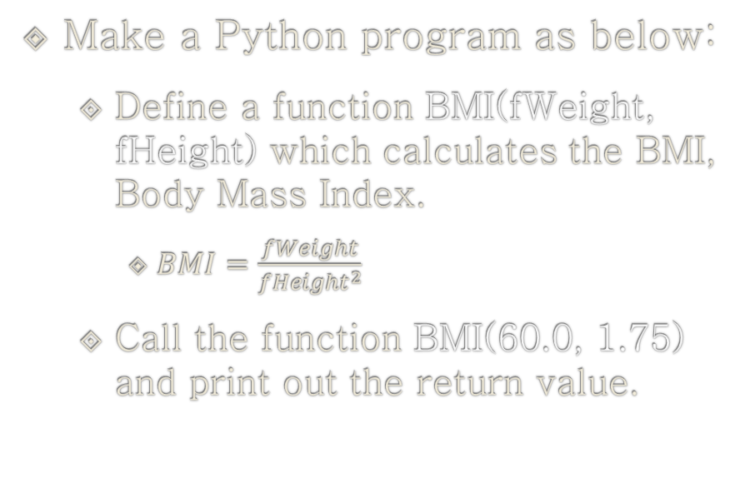
Practice: return
BMI(fWeight, fHeight)
Make a Python program as below:
Define a function BMI(fWeight, fHeight) which calculates the BMI, Body Mass Index.
$BMI=\frac{fWeight}{{fHeight}^{2}}$
Call the function BMI(60.0, 1.75) and print out the return value.
fBMI = fWeight / (fHeight ** 2)
return fBMI

Slide 97
Practice: return
Make a Python program as below:
Define a function BMI(fWeight, fHeight) which calculates BMI.
Input user’s weight (in kilo gram) and height (in meter), calculate BMI by calling the function BMI(fWeight, fHeight), and print out:
‘underweight’ if BMI <= 18.5
‘normal weight’ if 18.5 < BMI < 25.0
‘overweight’ if 25.0 <= BMI < 30.0
‘obesity’ if 30.0 <= BMI
fWeight = float(input())
fHeight = float(input())
fBMI = BMI(fWeight, fHeight)
fBMI <= 18.5
True
False
print('underweight')
fBMI <= 25.0
True
False
print('normal weight')
fBMI <= 30.0
True
False
print('overweight')
print('obesity')

Slide 98
Practice: return
Make a Python program as below:
Define a function BMI(fWeight, fHeight) which calculates BMI.
Add a Python program which:
Step 1) inputs a string for user’s weight (in kilo gram).
Step 2) terminates the program if the input string is equal to ‘quit’.
Step 3) inputs the other string for user’s height (in meter)
Step 4) transforms the two input strings into floats fWeight and fHeight, and calculate BMI by calling the function BMI(fWeight, fHeight).
Step 5) prints out:
‘underweight’ if BMI <= 18.5
‘normal weight’ if 18.5 < BMI < 25.0
‘overweight’ if 25.0 <= BMI < 30.0
‘obesity’ if 30.0 <= BMI
Step 6) goes to the Step 1).

Slide 99
Practice: return
def BMI(fWeight, fHeight):
return fWeight / (fHeight ** 2)
while True:
weight_input = input("Enter your weight in kilograms ('quit' to exit): ")
if weight_input.lower() == 'quit':
break
height_input = input("Enter your height in meters: ")
try:
fWeight = float(weight_input)
fHeight = float(height_input)
bmi = BMI(fWeight, fHeight)
if bmi <= 18.5:
print("BMI:", bmi, "- underweight")
elif 18.5 < bmi < 25.0:
print("BMI:", bmi, "- normal weight")
elif 25.0 <= bmi < 30.0:
print("BMI:", bmi, "- overweight")
else:
print("BMI:", bmi, "- obesity")
except ValueError:
print("Invalid input. Please enter numeric values for weight and height.")

Slide 100
Example: return
def BMI(fWeight, fHeight):
return fWeight / (fHeight ** 2)
print("m\kg", end=" ")
for iWeight in range(70, 81):
fWeight = float(iWeight)
if iWeight < 80:
print("{0:4.0f}".format(fWeight), end=" ")
else:
print("{0:4.0f}".format(fWeight))
for iHeight in range(155, 171):
fHeight = iHeight / 100.0
print("{0:4.2f}".format(fHeight), end=" ")
for iWeight in range(70, 81):
fWeight = float(iWeight)
fBMI = BMI(fWeight, fHeight)
if fBMI <= 18.5:
sBMI = "U"
elif fBMI < 25.0:
sBMI = "N"
elif fBMI < 30.0:
sBMI = "O"
else:
sBMI = "B"
if iWeight < 80:
print("{0:>4s}".format(sBMI), end=" ")
else:
print("{0:>4s}".format(sBMI), end="\n")
def BMI(fWeight, fHeight):
return fWeight / (fHeight ** 2)
print("m\kg", end=" ")
for iWeight in range(70, 81):
fWeight = float(iWeight)
if iWeight < 80:
print("{0:4.0f}".format(fWeight), end=" ")
else:
print("{0:4.0f}".format(fWeight))
for iHeight in range(155, 171):
fHeight = iHeight / 100.0
print("{0:4.2f}".format(fHeight), end=" ")
for iWeight in range(70, 81):
fWeight = float(iWeight)
fBMI = BMI(fWeight, fHeight)
if iWeight < 80:
print("{0:4.1f}".format(fBMI), end=" ")
else:
print("{0:4.1f}".format(fBMI), end="\n")

Slide 101
return statement
A return statement without a value is equivalent to return None.
None is a special type in Python that represents nothingness.
For example, it is used to indicate that a variable has no value if it has a value of None.
Every function implicitly contains a return None statement at the end unless you have written your own return statement.

Slide 102
Example: No return
def print_max(a, b):
if a > b:
print(a, 'is maximum')
elif a == b:
print(a, 'is equal to', b)
else:
print(b, 'is maximum')
# NO return
print(print_max(3, 4))
def print_max(a, b):
if a > b:
print(a, 'is maximum')
elif a == b:
print(a, 'is equal to', b)
else:
print(b, 'is maximum')
return
print(print_max(3, 4))

Slide 103
Example: return None
def print_max(a, b):
if a > b:
print(a, 'is maximum')
elif a == b:
print(a, 'is equal to', b)
else:
print(b, 'is maximum')
return None
print(print_max(3, 4))
def print_max(a, b):
if a > b:
print(a, 'is maximum')
elif a == b:
print(a, 'is equal to', b)
else:
print(b, 'is maximum')
return
print(print_max(3, 4))

Slide 104
Example: No return
def max(a, b):
if a > b:
return a
elif a == b:
return 'equal'
# NO else:
print(max(4, 3))
def max(a, b):
if a > b:
return a
elif a == b:
return 'equal'
# NO else:
print(max(3, 4))

Slide 105
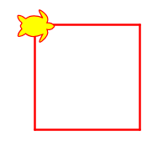
Practice
!pip install ColabTurtlePlus
from ColabTurtlePlus.Turtle import *
clearscreen()
setup(300,300)
showborder()
color("red", "yellow")
shape("turtle")
begin_fill()
for _ in range(4):
forward(100)
left(90)
circle(-50)
end_fill()
color("black","green")
right(90)을 함수를 사용하지 않고 오직 left(90)함수와 사용자정의함수를 사용하여 아래의 그림을 완성하라

Slide 106
Learning Objectives
Functions
Function Parameters
return statement
Local Variables
Default Argument Values
Keyword Arguments
VarArgs Parameters
DocStrings

Slide 107
Local Variables
When you declare variables inside a function definition, they are not related in any way to other variables with the same names used outside the function - i.e. variable names are local to the function.
This is called the scope of the variable.
All variables have the scope of the block they are declared in starting from the point of definition of the name.

Slide 108
Example: Scope
def func(x):
print('x is', x)
x = 2 # local variable
print('Changed local vriable x to func(x): ', x)
x = 50 # global variable
func(x)
print('The global variable x is still', x)

Slide 109
Example: Scope
def func(x):
print('x is', x)
x = 2
print('Changed local x to', x)
x = 50
func(x)
print('x is still', x)

Slide 110
The global statement
If you want to assign a value to a name defined at the top level of the program (i.e. not inside any kind of scope such as functions or classes), then you have to tell Python that the name is not local, but it is global.
We do this using the global statement.
It is impossible to assign a value to a variable defined outside a function without the global statement.
However, this is not encouraged and should be avoided since it becomes unclear to the reader of the program as to where that variable's definition is.
Using the global statement makes it amply clear that the variable is defined in an outermost block.

Slide 111
Example: global
def func():
global x
print('x is', x)
x = 2
print('Changed local x to', x)
x = 50
func()
print('x is now', x)

Slide 112
Example: global
def func():
global x
print('x is', x)
x = 2
print('Changed local x to', x)
x = 50
func()
print('x is now', x)

Slide 113
Example: global
def func():
global x
print('x is', x)
x = 2
print('Changed local x to', x)
x = 50
func()
print('x is now', x)
def func(x):
print('x is', x)
x = 2
print('Changed local x to', x)
x = 50
func(x)
print('x is still', x)

Slide 114
Example: global
Make a Python program as below:
Define a function swap() which declares x and y as global and swaps the value of x for the value of y.
Set x = 10 and y = 20.
Call the function swap().
Print out x and y.

Slide 115
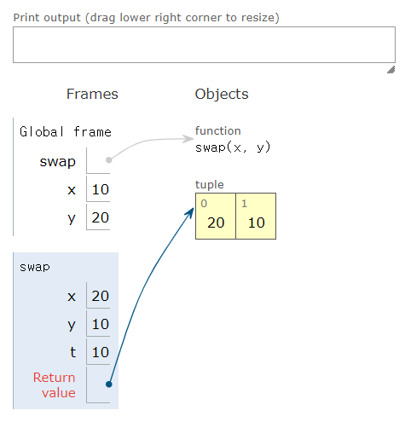
Example: global
def swap(x, y):
t = x
x = y
y = t
return x, y
x = 10
y = 20
print(swap(x, y))

Slide 116
Example: global
def swap():
global x, y # x, y를 전역변수로 사용
t = x
x = y
y = t
x = 10
y = 20
print(x, y)
swap()
print(x, y)

Slide 117
Learning Objectives
Functions
Function Parameters
return statement
Local Variables
Default Argument Values
Keyword Arguments
VarArgs Parameters
DocStrings

Slide 118
Default Argument Values
For some functions, you may want to make some parameters optional and use default values in case the user does not want to provide values for them.
This is done with the help of default argument values.
The default argument value should be a constant.
Only those parameters which are at the end of the parameter list can be given default argument values i.e. you cannot have a parameter with a default argument value preceding a parameter without a default argument value in the function's parameter list.
This is because the values are assigned to the parameters by position.
For example, def func(a, b=5) is valid, but def func(a=5, b) is not valid.

Slide 119
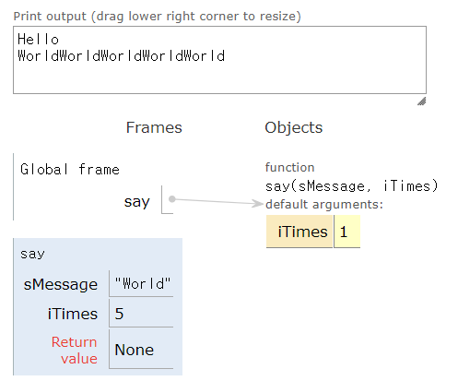
Example: Default Argument Values
def say(sMessage, iTimes=1):
print(sMessage * iTimes)
say("Hello")
say("World", 5)

Slide 120
Example: Default Argument Values
def say(sMessage="Hi", iTimes):
print(sMessage * iTimes)
say(5)
say("World", 5)
The default argument should come after the required arguments.
File "<ipython-input-17-a6440939a1d0>", line 1
def say(sMessage="Hi", iTimes): ^
SyntaxError: non-default argument follows default argument

Slide 121
Example: Default Argument Values
def say(sMessage="Hi", iTimes=1):
print(sMessage * iTimes)
say("Hello")
say("World", 5)
say()

Slide 122
Practice: Default Argument Values
Make a Python program as below:
Define a function printStudent(sSID, sName) which prints out the parameters, SID(student ID) and name.
The default argument value of parameter sName is "".
Call the function printStudent(sSID, sName) passing your SID and name as its arguments.

Slide 123
Practice: Default Argument Values
def printStudent(sSID, sName=""):
print("Student ID:", sSID)
if sName: # sName ="" 이면 False,즉 이름이 있을때만 출력
print("Name:", sName)
# Replace 'YOUR_SID' and 'Your Name' with your actual student ID and name
your_SID = input('What is your SID ? ')
your_name = input('What is your name ? ')
# Call the function to print out your SID and name
printStudent(your_SID, your_name)

Slide 124
Learning Objectives
Functions
Function Parameters
return statement
Local Variables
Default Argument Values
Keyword Arguments
VarArgs Parameters
DocStrings

Slide 125
Keyword Arguments
If you have some functions with many parameters and you want to specify only some of them, then you can give values for such parameters by naming them - this is called keyword arguments - we use the name (keyword) instead of the position (which we have been using all along) to specify the arguments to the function.
There are two advantages:
Using the function is easier since we do not need to worry about the order of the arguments.
We can give values to only those parameters to which we want to, provided that the other parameters have default argument values.

Slide 126
Example: Keyword Arguments
def func(a, b=5, c=10):
print('a is', a, ', b is', b, 'and c is', c)
func(3, 7) # func(3, 7, 10)
func(25, c=24) # func(25, 5, 24)
func(c=50, a=100) # func(100, 5, 50)

Slide 127
Example: Default Argument Values
def func(a=1, b, c=10):
print('a is', a, ', b is', b, 'and c is', c)
func(3, 7) # func(3, 7, 10)
func(25, c=24) # func(25, 5, 24)
func(c=50, a=100) # func(100, 5, 50)

Slide 128
Usage: Keyword Arguments
import sklearn.model_selection
import sklearn.model_selection
import sklearn.neighbors
from sklearn.datasets import load_iris
X, y = load_iris(return_X_y = True)
X_train, X_test, y_train, y_test = sklearn.model_selection.train_test_split(X, y, random_state=0)
clf = sklearn.neighbors.KNeighborsClassifier(n_neighbors=3)
clf.fit(X_train, y_train) # machine learning to make model (=algorithm(X))
clf.predict(X_test) # predict classification
clf.predict_proba(X_test) # calculate probability of the prediction

Slide 129
Usage: Keyword Arguments * https://scikit-learn.org/stable/modules/generated/sklearn.model_selection.train_test_split.html
Syntax | sklearn.model_selection.train_test_split(*arrays, **options)
Parameters | *arrays: sequence of indexables with same length / shape[0] test_size: float, int or None, optional (default=None) train_size: float, int, or None, (default=None) random_state: int, RandomState instance or None, optional (default=None) shuffle: boolean, optional (default=True) stratify: array-like or None (default=None)
Returns | splitting: list, length=2 * len(arrays)

Slide 130
Learning Objectives
Functions
Function Parameters
return statement
Local Variables
Default Argument Values
Keyword Arguments
VarArgs Parameters
DocStrings

Slide 131
VarArgs Parameters
Sometimes you might want to define a function that can take any number of parameters, i.e. variable number of arguments, this can be achieved by using the stars.
When we declare a starred parameter such as *param, then all the positional arguments from that point till the end are collected as a tuple called 'param'.
Similarly, when we declare a double-starred parameter such as **param, then all the keyword arguments from that point till the end are collected as a dictionary called 'param'.
We will explore tuples and dictionaries in a later class.

Slide 132
Example: VarArgs Parameters
def total(a=5, *tiNumbers, **dPhonebook):
print("a", a) # value
print("tiNumbers", tiNumbers) # tuple
print("dPhonebook", dPhonebook) # dictionary
total(10, 1, 2, 3, 6, Jack=1123, John=2231, Inge=1560)

Slide 133
Example: VarArgs Parameters
def total(a=5, *tiNumbers, **dPhonebook):
print("a", a)
print()
for iSingle_item in tiNumbers:
print(iSingle_item)
print()
for sFirst_part, iSecond_part in dPhonebook.items():
print(sFirst_part, iSecond_part)
total(10, 1, 2, 3, 6, Jack=1123, John=2231, Inge=1560)

Slide 134
Example: VarArgs Parameters
Make a Python program as below:
Define a function isPrime(n) which returns whether n is prime (True) or not (False).
Define a function printPrimes(*tiNumbers) which prints out the prime numbers among VarArgs numbers.
Call the function printPrimes(2, 3, 4, 5, 6, 7, 8, 9, 10).

Slide 135
Example: VarArgs Parameters
import math
def isPrime(n):
if n <= 1:
return False
for d in range(2, int(math.sqrt(n)) + 1):
if n % d == 0:
return False
return True
def printPrimes(*tiNumbers):
for n in tiNumbers:
if isPrime(n):
print(n)
printPrimes(2, 3, 4, 5, 6, 7, 8, 9, 10)

Slide 136
Learning Objectives
Functions
Function Parameters
return statement
Local Variables
Default Argument Values
Keyword Arguments
VarArgs Parameters
DocStrings

Slide 137
DocStrings
Python has a nifty feature called documentation strings, usually referred to by its shorter name docstrings.
DocStrings are an important tool that you should make use of since it helps to document the program better and makes it easier to understand.
Amazingly, we can even get the docstring (__doc__) back from, say a function, when the program is actually running!
Note that DocStrings also apply to modules and classes which we will learn about in the respective classes.

Slide 138
Example: DocStrings
def print_max(x, y):
'''Prints the maximum of two numbers.
The two values must be integers.'''
x = int(x)
y = int(y)
if x > y:
print(x, 'is maximum')
else:
print(y, 'is maximum')
print_max(3, 5)
print(print_max.__doc__) # double underscores

Slide 139
Classes
from abc import *
class ATest(metaclass=ABCMeta):
@classmethod
@abstractmethod
def _Get(cls):
print('A._Get', end='')
@classmethod
def Get(cls):
print('A.Get -> ', end='')
cls._Get()
@abstractmethod
def _get(self):
print('A._get', end='')
def get(self):
print('A.get -> ', end='')
self._get()
class BTest(ATest):
@classmethod
def _Get(cls):
print('B._Get -> ', end='')
super()._Get()
def _get(self):
print('B._get -> ', end='')
super()._get()
test = BTest()
test._Get(); print()
test.Get(); print()
test._get(); print()
test.get(); print()

Slide 140
Summary
Functions
Function Parameters
return statement
Local Variables
Default Argument Values
Keyword Arguments
VarArgs Parameters
DocStrings

Slide 141
End of Python: Functions

Slide 142
Python: Modules and Packages

Slide 143
Topic Structure
Task | Single Value | Multiple Values | numpy, pandas
Presentation (value, variable) | int, float, string, boolean | list, tuple, dictionary, set | ndarray, Series, DataFrame
Operation (algebra) | expressions | operations, mutable operations | expressions, get, set, reshape, …
Control flow | if for while
Use and reuse | Functions Standard libraries Modules and Packages
Input and output | Standard I/O File I/O |  | Standard I/O File I/O CSV, Excel

Slide 144
Learning Objectives
Modules
Importing and Using Standard Library
Making Your Own Modules
The dir function
Packages

Slide 145
Modules
What if you wanted to reuse a number of functions in other programs that you write?
The answer is modules.
A module can be imported by another program to make use of its functionality.
This is how we can use the Python standard library as well.

Slide 146
Learning Objectives
Modules
Importing and Using Standard Library
Making Your Own Modules
The dir function
Packages

Slide 147
Example: Importing and Using System Library
import sys
print("The command line arguments are:")
for i in sys.argv:
print(i)
print("\n\nThe PYTHONPATH is", sys.path, "\n")
# the sys.argv contains the list of command line arguments
# i.e. the arguments passed to your program using the command line.
# The sys.path contains the list of directory names where modules are imported from.
# Refer to https://docs.python.org/3/library/sys.html

Slide 148
Example: Importing and Using System Library
import sys
print("The command line arguments are:")
for i in sys.argv:
print(i)
print("\n\nThe PYTHONPATH is", sys.path, "\n")
# the sys.argv contains the list of command line arguments i.e. the arguments passed to your program using the command line.
# The sys.path contains the list of directory names where modules are imported from.
# Refer to https://docs.python.org/3/library/sys.html

Slide 149
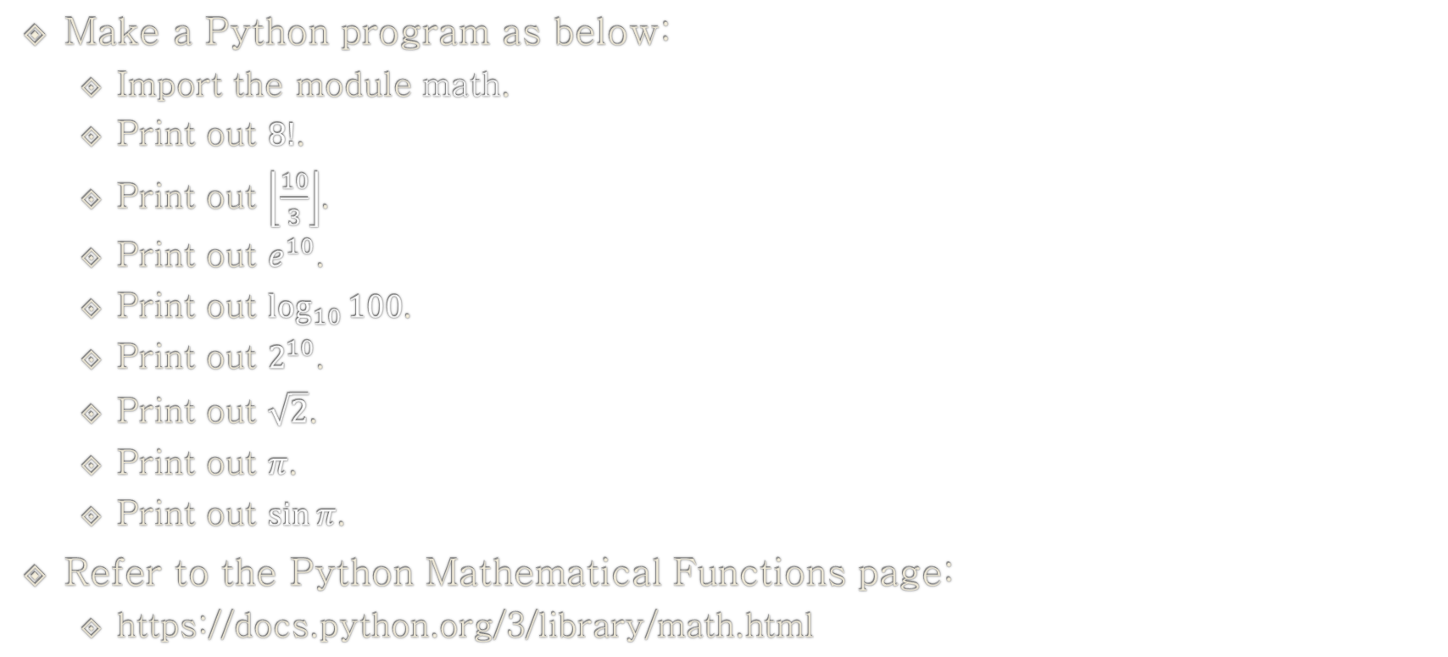
Example: Importing and Using Mathematical Library
Make a Python program as below:
Import the module math.
Print out $8!$.
Print out $\left\lfloor \frac{10}{3}\right\rfloor$.
Print out $e^{10}$.
Print out $\log_{10}{100}$.
Print out $2^{10}$.
Print out $\sqrt{2}$.
Print out $π$.
Print out $\sin{π}$.
Refer to the Python Mathematical Functions page:
https://docs.python.org/3/library/math.html

Slide 150
Example: Importing and Using Mathematical Library
import math
print(math.factorial(8))
print(math.floor(10 / 3))
print(math.exp(10))
print(math.log(100, 10))
print(math.pow(2, 10))
print(math.sqrt(2))
print(math.pi)
print(math.sin(math.pi))

Slide 151
The from..import statement
If you want to directly import the argv variable into your program (to avoid typing the sys. every time for it), then you can use the from sys import argv statement.
e.g.
import math
print("Square root of 16 is", math.sqrt(16))
e.g.
from math import sqrt
print("Square root of 16 is", sqrt(16))
e.g.
from math import *
print("Square root of 16 is", sqrt(16))

Slide 152
A module's __name__
Every module has a name and statements in a module can find out the name of their module.
This can be achieved using the __name__ attribute of the module.
e.g.
if __name__ == '__main__':
print('This program is being run by itself')
else:
print('I am being imported from another module')

Slide 153
Learning Objectives
Modules
Importing and Using Standard Library
Making Your Own Modules
The dir function
Packages

Slide 154
Making Your Own Modules
Every Python program is also a module.
You just have to make sure it has a .py extension.
The module should be placed either in the same directory as the program from which we import it, or in one of the directories listed in sys.path.
We use the same dotted notation to access members of the module.

Slide 155
Example: Making and Using Your Own Modules
File mymodule.py:
def say_hi():
print('Hi, this is mymodule speaking.')
__version__ = '0.1'
File mymodule_demo.py:
import mymodule
mymodule.say_hi()
print('Version', mymodule.__version__)

Slide 156
Example: Making and Using Your Own Modules (from..import)
File mymodule.py:
def say_hi():
print('Hi, this is mymodule speaking.')
__version__ = '0.1'
File mymodule_demo2.py:
from mymodule import say_hi, __version__
say_hi()
print('Version', __version__)
It is always recommended to prefer the import statement even though it might make your program a little longer.

Slide 157
Example: Making and Using Your Own Modules (from..import *)
File mymodule.py:
def say_hi():
print('Hi, this is mymodule speaking.')
__version__ = '0.1'
File mymodule_demo3.py:
from mymodule import *
say_hi()
print('Version', __version__)
You should avoid using import-star, i.e. from mymodule import *.

Slide 158
Practice: Making and Using Your Own Modules
Create a file ‘mymath.py’ which contains:
A function isPrime(n) which returns whether n is prime (True) or not (False).
A function printPrimes(*tiNumbers) which prints out the prime numbers among VarArgs numbers.
Create a file ‘mymain.py’ which:
Calls the function printPrimes(2, 3, 4, 5, 6, 7, 8, 9, 10).

Slide 159
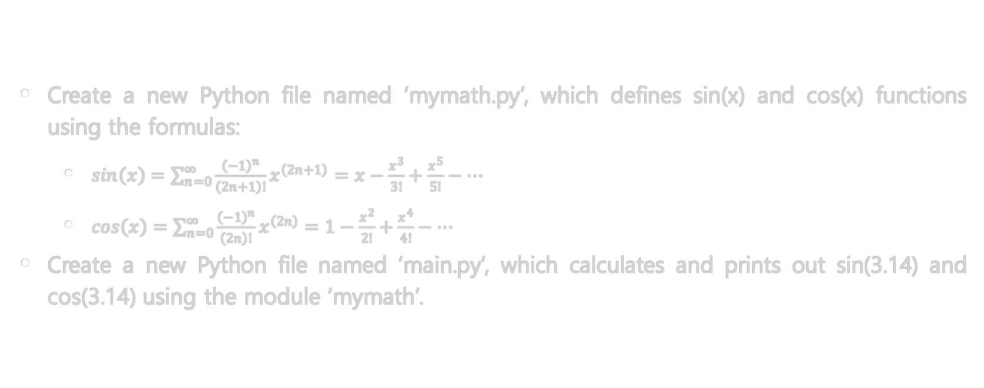
Practice: Making and Using Your Own Modules
Create a new Python file named ‘mymath.py’, which defines sin(x) and cos(x) functions using the formulas:
$\sin\left(x\right)=\sum_{n=0}^{∞}{\frac{{\left(−1\right)}^{n}}{\left(2n+1\right)!}x^{\left(2n+1\right)}}=x−\frac{x^{3}}{3!}+\frac{x^{5}}{5!}−…$
$\cos\left(x\right)=\sum_{n=0}^{∞}{\frac{{\left(−1\right)}^{n}}{\left(2n\right)!}x^{\left(2n\right)}}=1−\frac{x^{2}}{2!}+\frac{x^{4}}{4!}−…$
Create a new Python file named ‘main.py’, which calculates and prints out sin(3.14) and cos(3.14) using the module ‘mymath’.

Slide 160
Learning Objectives
Modules
Importing and Using Standard Library
Making Your Own Modules
The dir function
Packages

Slide 161
The dir function
Built-in dir function returns list of names defined by an object.
If the object is a module, this list includes functions, classes and variables, defined inside that module.
This function can accept arguments.
If the argument is the name of the module, function returns list of names from that specified module.
If there is no argument, function returns list of names from the current module.

Slide 162
Example: dir
import sys
print(dir(sys))
a = 5
print(dir())
print(vars())
del a
print(dir())
print(vars())
The dir function works on any object. For example, run dir(str) for the attributes of the str (string) class.
There is also a vars function which can potentially give you the attributes and their values, but it will not work for all cases.
The del statement is used to delete a variable/name and after the statement has run, in this case del a, you can no longer access the variable a - it is as if it never existed before at all.

Slide 163
Learning Objectives
Modules
Importing and Using Standard Library
Making Your Own Modules
The dir function
Packages

Slide 164
Packages
A package as a container of modules
A package for distribution

Slide 165
Packages
A package as a container of modules
A package for distribution

Slide 166
Packages (A Container of Modules)
Packages are a convenience to hierarchically organize modules.
Packages are just folders of modules with a special __init__.py file that indicates to Python that this folder is special because it contains Python modules.

Slide 167
Example: Packages
- <some folder present in the sys.path>
- Folder: world
- File: __init__.py
- Folder: asia
- File: __init__.py
- Folder: india
- File: __init__.py
- File: foo.py
- Folder: africa
- File: __init__.py
- Folder: madagascar
- File: __init__.py
- File: bar.py

Slide 168
Packages
A package as a container of modules
A package for distribution

Slide 169
Packages (Distributions)
Note that the term ‘package’ in this context is being used as a synonym for a distribution (i.e. a bundle of software to be installed), not to refer to the kind of package that you import in your Python source code (i.e. a container of modules).
It is common in the Python community to refer to a distribution using the term ‘package’.

Slide 170
Packages: Requirements for Installing Packages
Ensure you can run Python from the command line
python –version
Ensure you can run pip from the command line
pip –version
Ensure pip, setuptools, and wheel are up to date
python -m pip install --upgrade pip setuptools wheel

Slide 171
Packages: Requirements for Installing Packages
Ensure you can run Python from the command line
python –version
Ensure you can run pip from the command line
pip –version
Ensure pip, setuptools, and wheel are up to date
python -m pip install --upgrade pip setuptools wheel

Slide 172
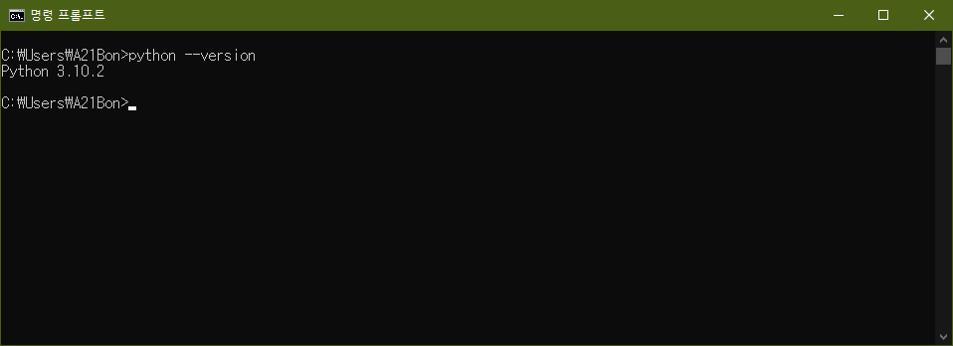
Packages: Requirements for Installing Packages

Slide 173
Packages: Requirements for Installing Packages
Ensure you can run Python from the command line
python –version
Ensure you can run pip from the command line
pip –version
Ensure pip, setuptools, and wheel are up to date
python -m pip install --upgrade pip setuptools wheel

Slide 174
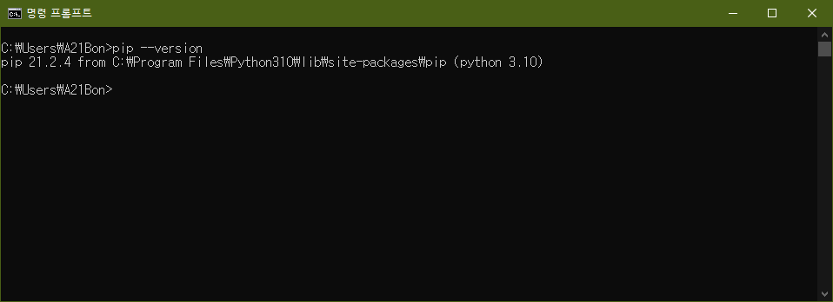
Packages: Requirements for Installing Packages

Slide 175
Packages: Requirements for Installing Packages
Ensure you can run Python from the command line
python –version
Ensure you can run pip from the command line
pip –version
Ensure pip, setuptools, and wheel are up to date
python -m pip install --upgrade pip setuptools wheel

Slide 176
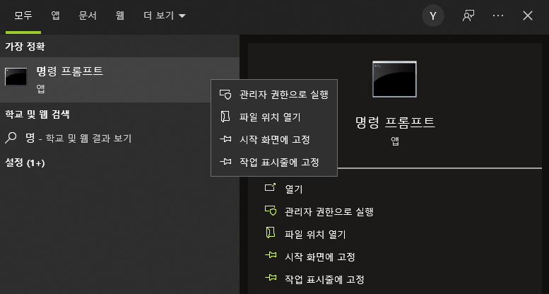
Packages: Requirements for Installing Packages
‘명령 프롬프트’ 관리자 권한으로 실행

Slide 177
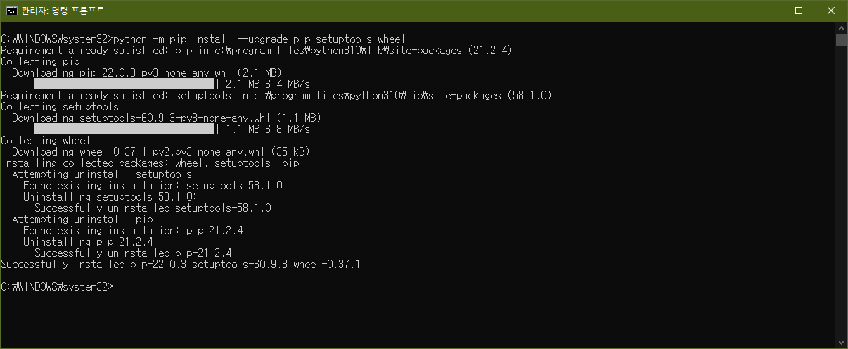
Packages: Requirements for Installing Packages

Slide 178
Packages: Installing Packages from PyPI (Python Package Index)
To install the latest version of “SomeProject”:
pip install "SomeProject"
PyPI is the default Package Index for the Python community.
It is open to all Python developers to consume and distribute their distributions.
Visit https://pypi.org/ to find Python packages.

Slide 179
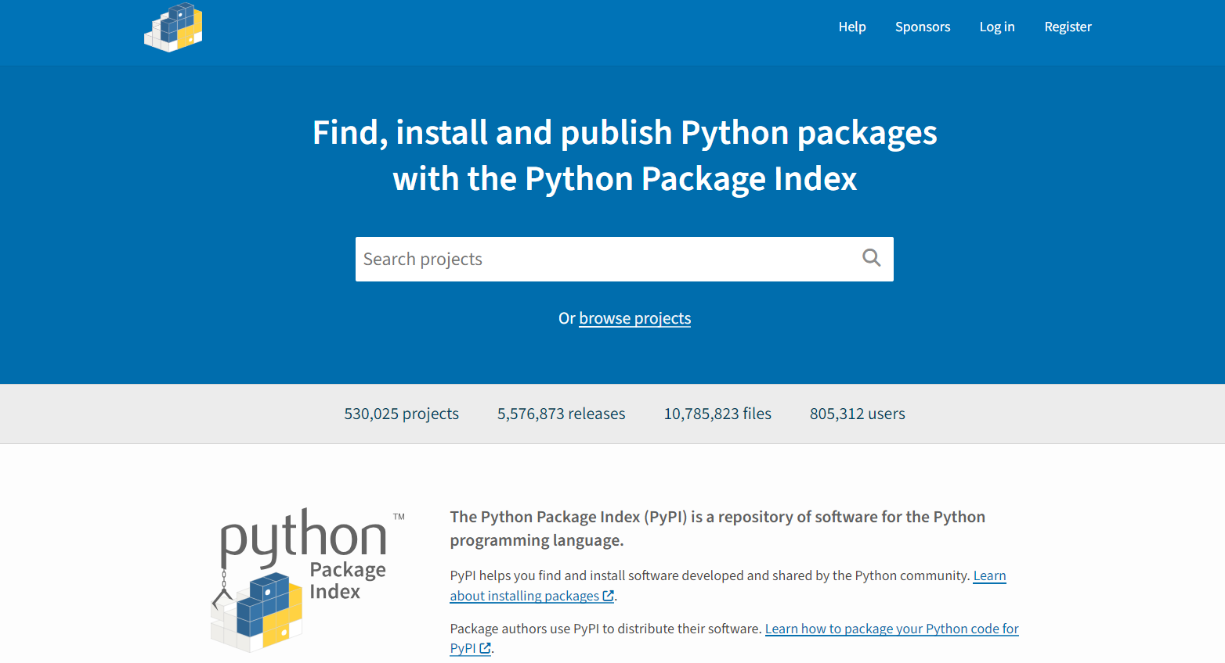
Example: Finding Packages regarding ‘statistics’

Slide 180
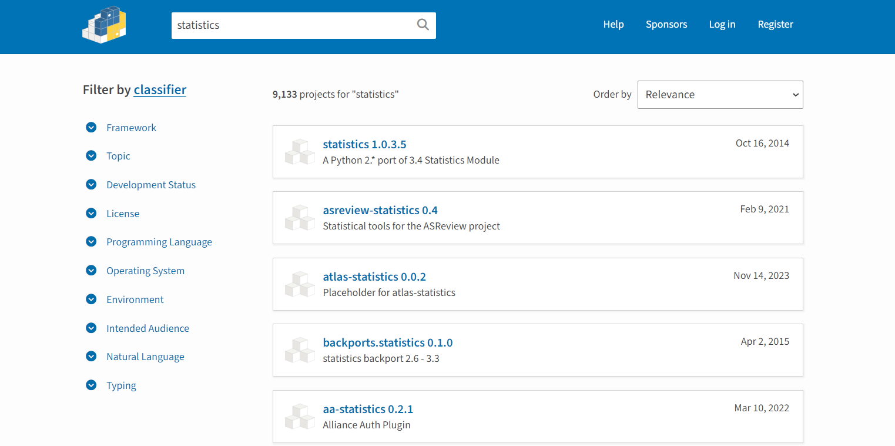
Example: Finding Packages regarding ‘statistics’

Slide 181
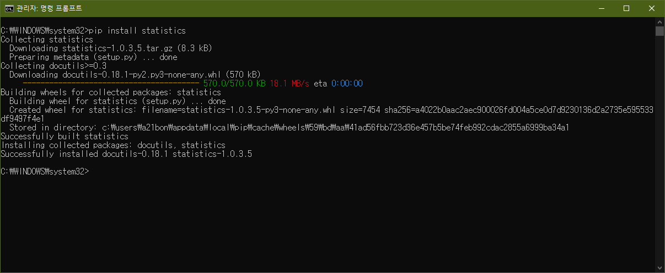
Example: Installing "statistics"
pip install "statistics“

Slide 182
The statistics Module
Function | Description
mean() | Arithmetic mean (“average”) of data.
harmonic_mean() | Harmonic mean of data.
median() | Median (middle value) of data.
median_low() | Low median of data.
median_high() | High median of data.
median_grouped() | Median, or 50th percentile, of grouped data.
mode() | Mode (most common value) of discrete data.
pstdev() | Population standard deviation of data.
pvariance() | Population variance of data.
stdev() | Sample standard deviation of data.
variance() | Sample variance of data.

Slide 183
Example: statistics
import statistics
liValue = [1, 2, 3, 4, 5]
print(statistics.mean(liValue))
print(statistics.variance(liValue))

Slide 184
Example: statistics
Make a Python program as below:
Import the module statistics.
Calculate and print out the mean of the data below.
Calculate and print out the median of the data below.
Calculate and print out the sample variance of the data below.
Calculate and print out the sample standard deviation of the data below.
Calculate and print out the population variance of the data below.
Calculate and print out the population standard deviation of the data below.
100, 98, 21, 57, 89, 24, 65, 78, 88, 37

Slide 185
Example: statistics
import statistics
liValue = [100, 98, 21, 57, 89, 24, 65, 78, 88, 37]
print(statistics.mean(liValue))
print(statistics.median(liValue))
print(statistics.variance(liValue))
print(statistics.stdev(liValue))
print(statistics.pvariance(liValue))
print(statistics.pstdev(liValue))

Slide 186
Practice: statistics
Create a new Python file named ‘stat.py’, which imports the module statistics.
Calculate and print out mean, median, mode, variance, and standard deviation for the following sample data:
1,3,4,2,3,1,7,4,5,7,8,9,0,3,5,6,8,2,3,5

Slide 187
Packages: Upgrading Packages from PyPI (Python Package Index)
To upgrade an already installed SomeProject to the latest from PyPI:
pip install --upgrade SomeProject

Slide 188
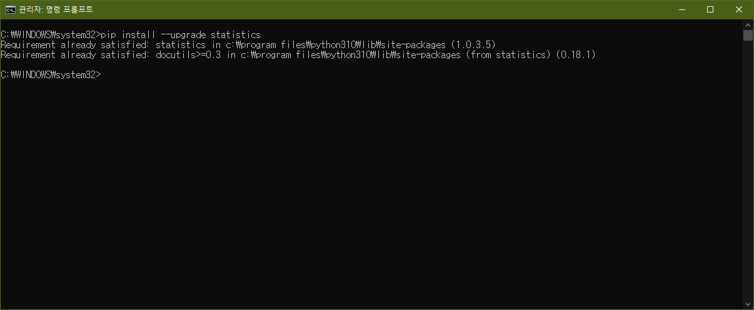
Packages: Upgrading Packages from PyPI (Python Package Index)
pip install --upgrade statistics

Slide 189
Summary
Modules
Importing and Using Standard Library
Making Your Own Modules
The dir function
Packages

Slide 190

End of Python: Modules and Packages

